Slide 1

Nutrient availability increases leaf nitrogen at the expense of whole plant growth in a closed canopy temperate forest
Evan A. Perkowski¹; David W. Frey²; Christine L. Goodale²; Nicholas G. Smith¹
¹Dept. of Biological Sciences, Texas Tech University
²Dept. of Ecology and Evolutionary Biology, Cornell University

Slide 2
Leaf nitrogen is a common surrogate for estimating leaf-level photosynthetic capacity
@EvanPerkowski
Evans (1989) Oecologia
Notes:
I want to start off this talk by briefly talking about relationships between soil nitrogen, leaf nitrogen, and leaf level photosynthetic capacity.
First, I want to talk about relationships between leaf nitrogen and leaf-level photosynthetic capacity
This figure is from John Evans’ work in 1989 on relationships between leaf nitrogen and C3 photosynthesis.
On the x-axis is total leaf nitrogen, measured on a leaf area basis and on the y-axis is light-saturated photosynthesis, also measured on an area basis
The different shaped points represent different C3 species.
You can see that within each species, there is generally a tightly correlated and positive relationship between leaf nitrogen and light saturated photosynthesis
This is because a rather large fraction of leaf nitrogen gets allocated toward enzymes, such as Rubisco, that move photosynthetic reactions forward

Slide 3
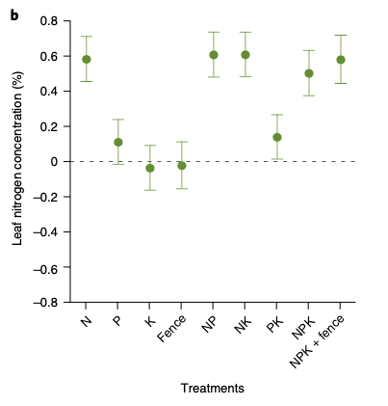
Soil nitrogen has been shown to positively influence leaf nitrogen
@EvanPerkowski
Firn et al. (2019) Nature
Notes:
Second, I want to talk about relationships between leaf nitrogen and soil nitrogen
Soil nitrogen has been shown to positively influence leaf nitrogen in a fair share of studies.
This figure is from a study by Jenn Firn in 2019 using a globally coordinated nutrient addition experiment by the name Nutrient Network.
In these experiments, nitrogen, phosphorus, and potassium are added in a full-factorial field manipulation in grassland systems
On the x-axis is the different combinations of nutrient additions, and on the y-axis is leaf nitrogen concentrations

Slide 4
Soil nitrogen has been shown to positively influence leaf nitrogen
Plots that received nitrogen had higher leaf nitrogen content
@EvanPerkowski
Firn et al. (2019) Nature
Notes:
You can see that there is a pretty obvious increase in leaf nitrogen content in plots that receive nitrogen fertilizer regardless of potassium and phosphorus combinations

Slide 5
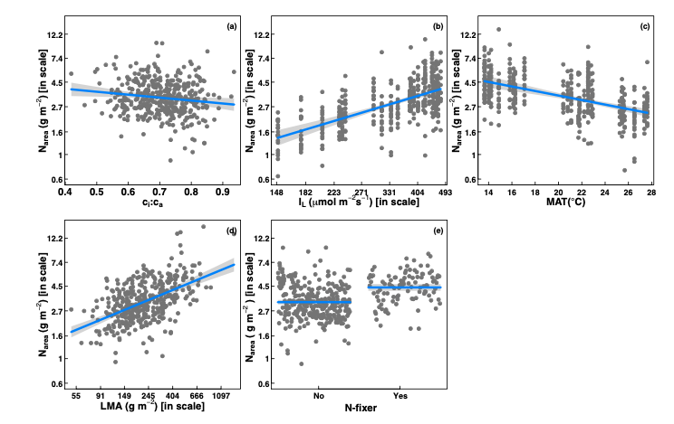
However, leaf nitrogen can also be predicted independent of soil nitrogen
@EvanPerkowski
Dong et al. (2017) Biogeosciences
Notes:
Some recent work has also shown that leaf nitrogen can be predicted independent of soil nitrogen availability
This is work from Ning Dong showing on the top row in panel b and c that leaf nitrogen can be predicted from photosynthetically active radiation, which is basically light, and mean annual temperature.
Additionally, they show in panel a that leaf nitrogen can be predicted by the ratio of intercellular carbon dioxide to extracellular carbon dioxide, or Ci:Ca,
In panel d, they show that leaf nitrogen can be predicted through leaf mass per area, and in panel e show that leaf nitrogen can be predicted on the basis of whether a species can associate with nitrogen-fixing bacteria
Thus, aboveground climate and leaf traits can be used to predict patterns of leaf nitrogen

Slide 6
Leaf nitrogen is likely a product of plant allocation responses to soil nitrogen and climate
@EvanPerkowski
Notes:
While we know that variation in leaf nitrogen can be explained by soil nitrogen availability, climate, or plant traits, we still do not have a firm grasp of what drives leaf nitrogen content.
It is possible that these patterns are driven by plant allocation responses to soil nitrogen and climate, but we lack data that links these responses to physiological processes that range from the leaf to whole plant level

Slide 7
Yet, we do not fully understand when and where soil nitrogen impacts nitrogen allocation to leaf tissue vs. other tissues
@EvanPerkowski
Notes:
Even further, we still do not fully understand when and where plants allocate nitrogen to leaves, and for what mechanism and process. This is mostly due to a lack of photosynthetic data that connects leaf nitrogen to physiological functions.
Nitrogen manipulation experiments could be particularly useful in elucidating mechanisms and environmental contexts that driven leaf nitrogen allocation

Slide 8
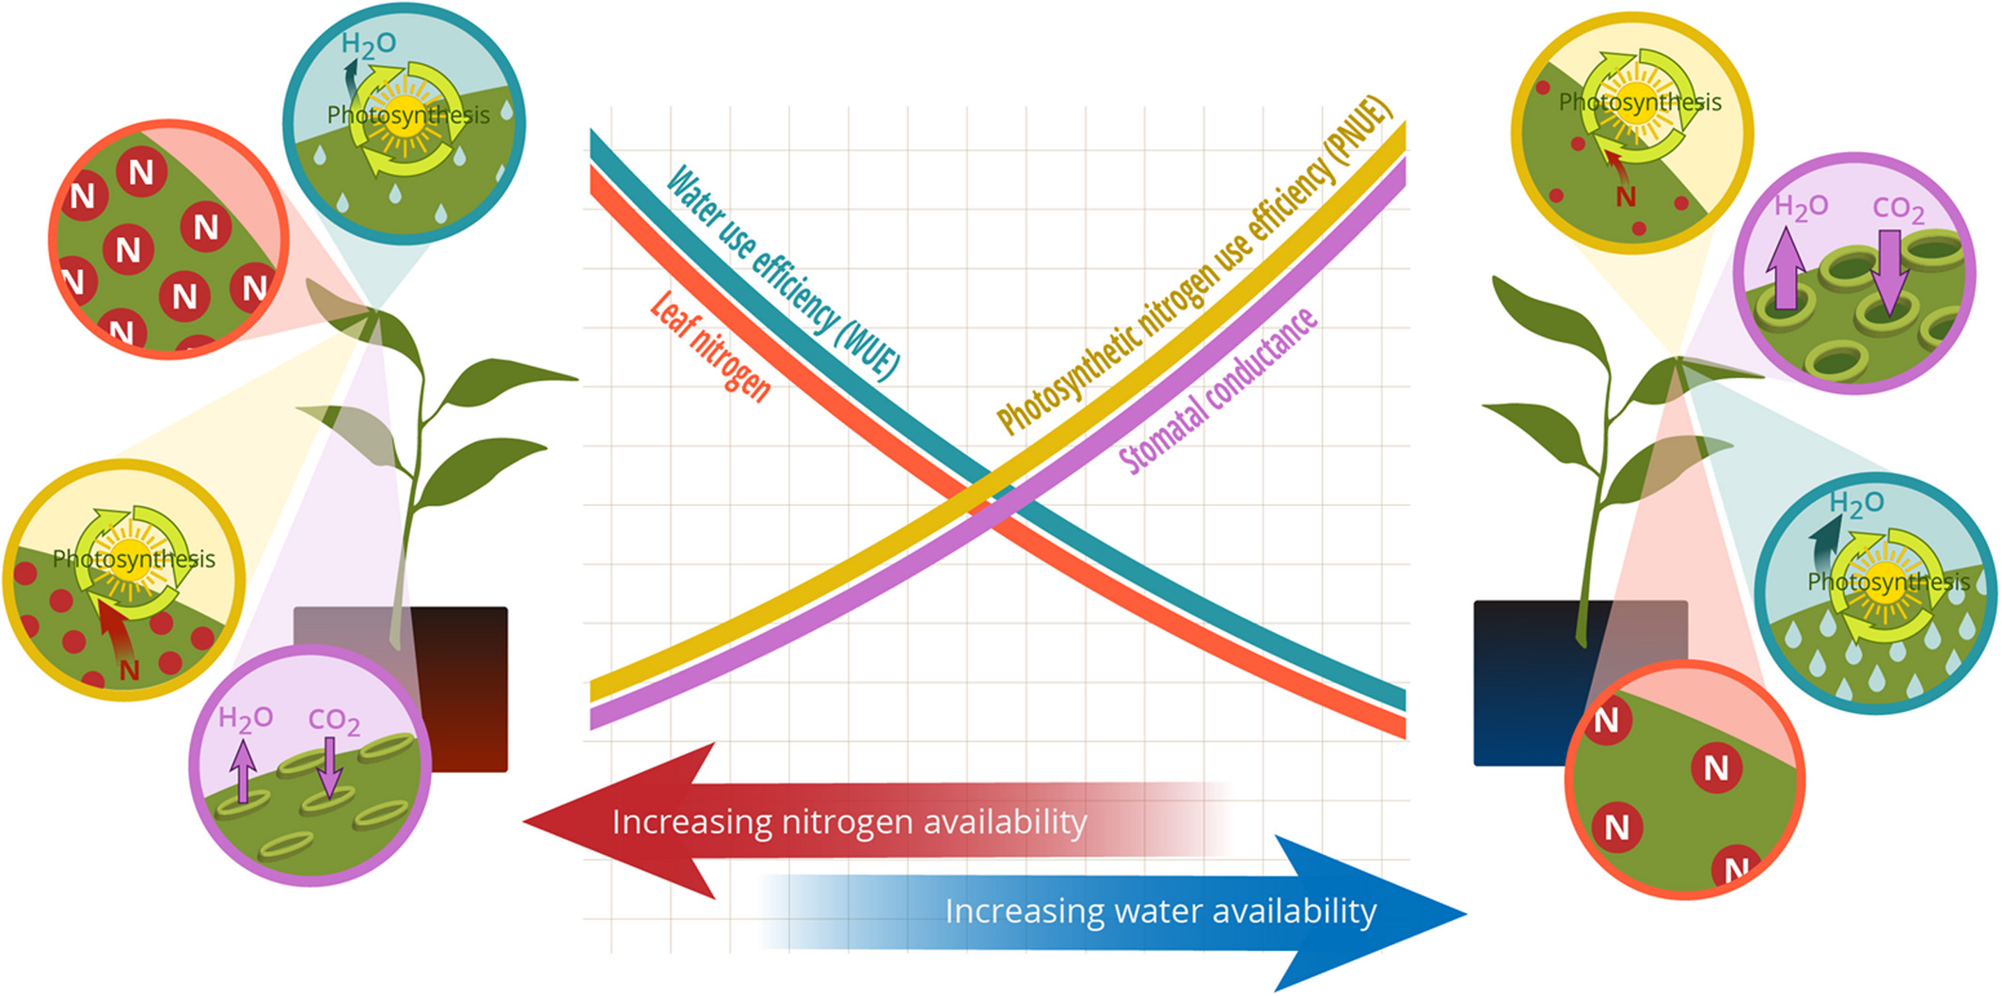
Option #1: Maintain photosynthesis with greater water-use efficiency at expense of photosynthetic nitrogen-use efficiency
@EvanPerkowski
Bialic-Murphy et al. (2021) Ecol. Letters
Notes:
There are two allocation pathways that could alter leaf nitrogen allocation.
At the leaf level, plants might allocate nitrogen to photosynthetic leaf tissue based on leaf nitrogen demand to build and maintain photosynthetic machinery.
This option is predicated on recent optimality frameworks suggesting that plants can and should trade inefficient use of an abundant resource for efficiency a more limited limiting resource.
For example, if nitrogen is relatively more available than water, then plants can maintain a similar photosynthetic output by increasing nitrogen allocation toward photosynthetic leaf tissue in order to increase water-use efficiency.
We might expect these patterns would be observed in arid systems where water is relatively less available than nitrogen

Slide 9
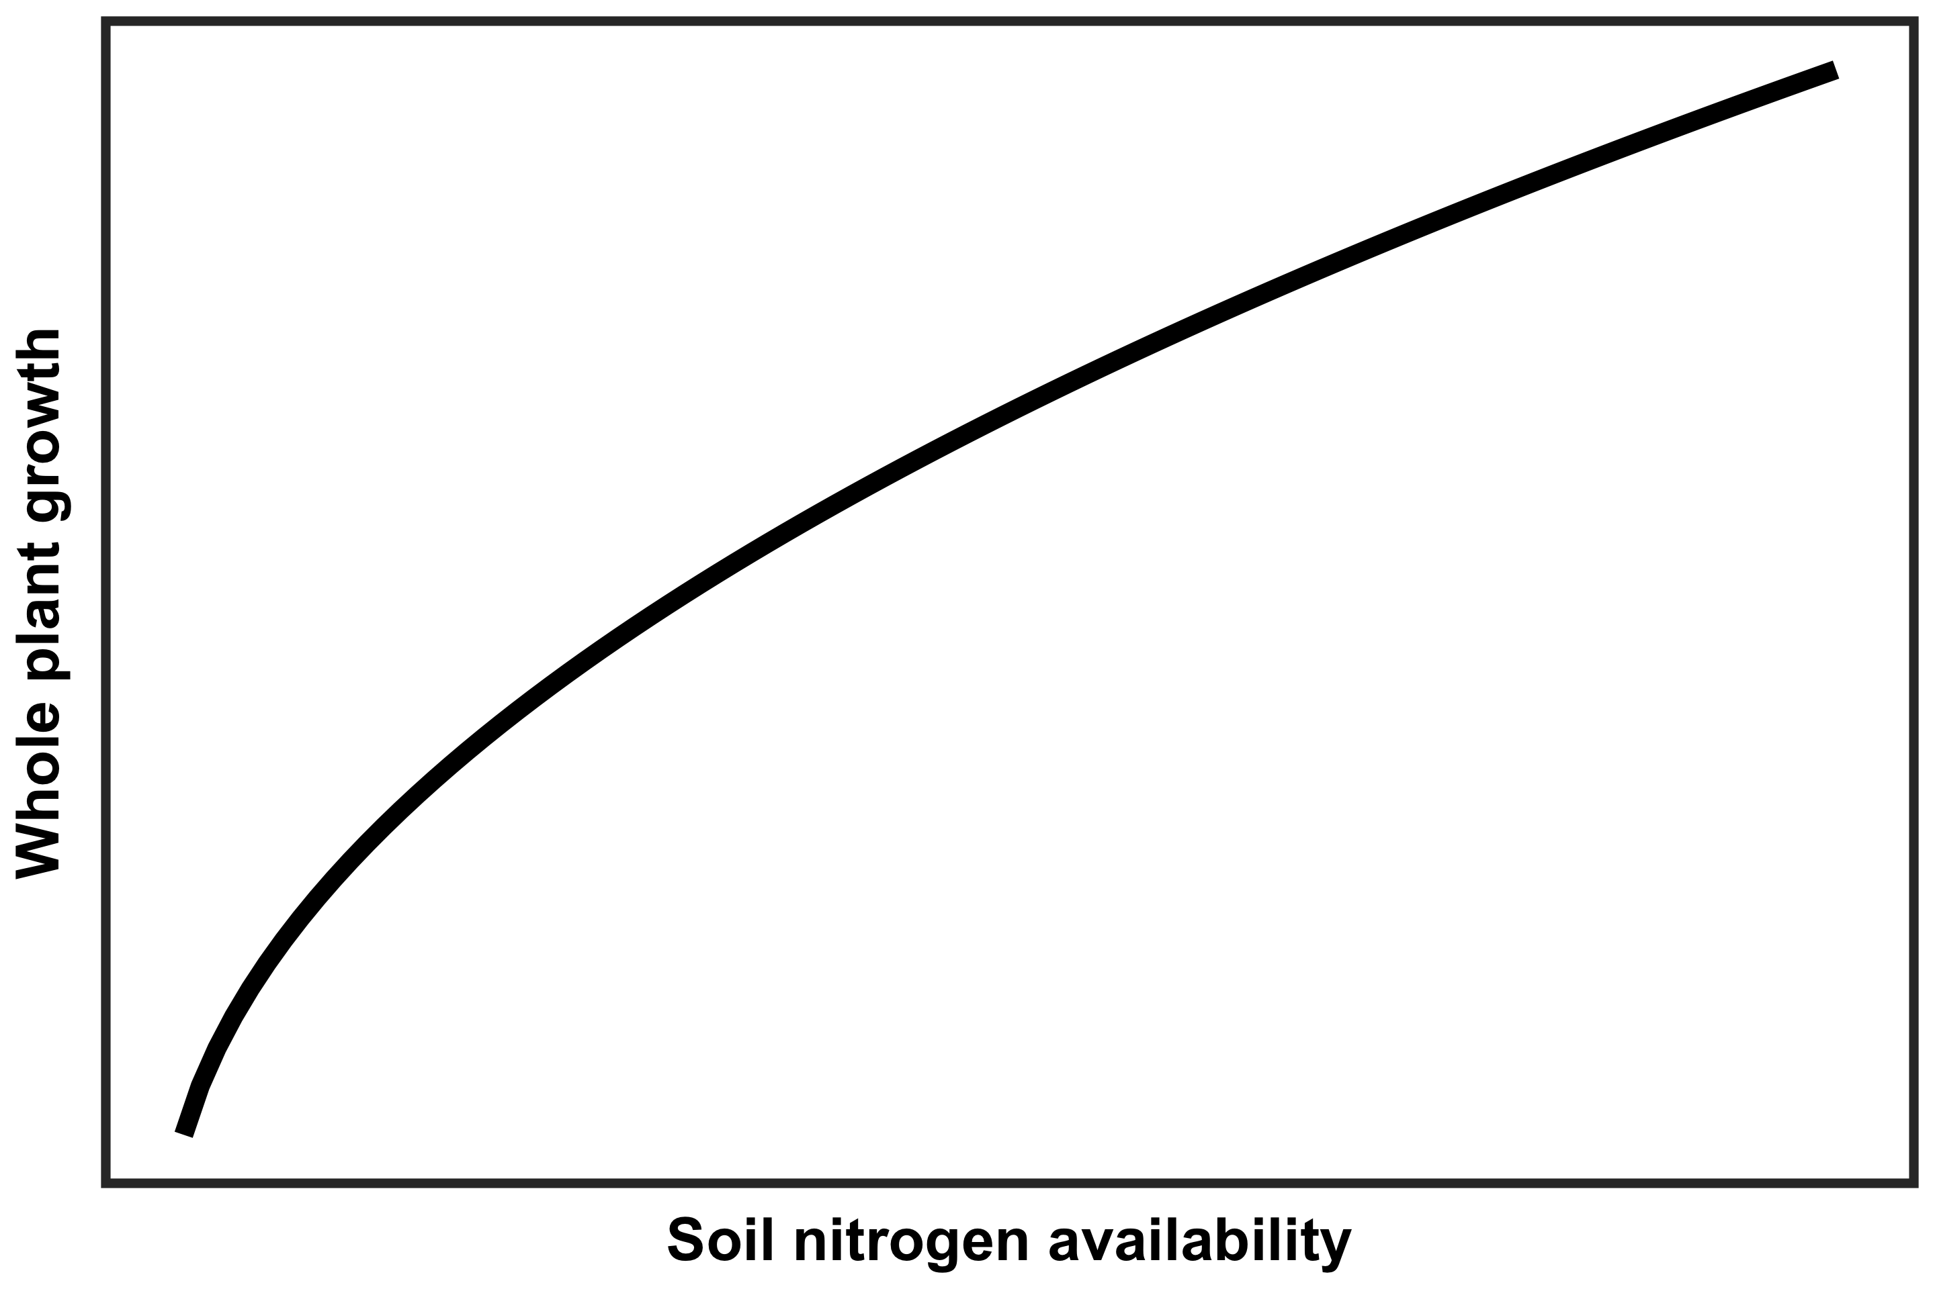
Option #2: Invest extra nitrogen toward whole plant growth at expense of leaf nitrogen
@EvanPerkowski
Notes:
Alternatively, plants may allocate nitrogen to photosynthetic leaf tissue based on tradeoffs between leaf-level nitrogen demand and whole plant nitrogen demand.
In other words, if plants invest extra nitrogen toward whole plant growth, then this should come at the expense of leaf nitrogen.
This could be indexed through increased nitrogen investment in leaf quantity over quality, or toward maintenance of structural tissue essential for the survival and reproduction of an individual

Slide 10
Study Question
How do leaf and whole plant processes respond to soil nutrient availability in a closed canopy system?
@EvanPerkowski
Notes:
These two options remain to be well-tested. A few environmental gradient analyses support these patterns, but we have not yet examined these options in a manipulative context.
We were interested in using a field manipulation experiment to answer the following question: How do leaf and whole plant processes respond to soil nutrient availability in a closed canopy system?

Slide 11
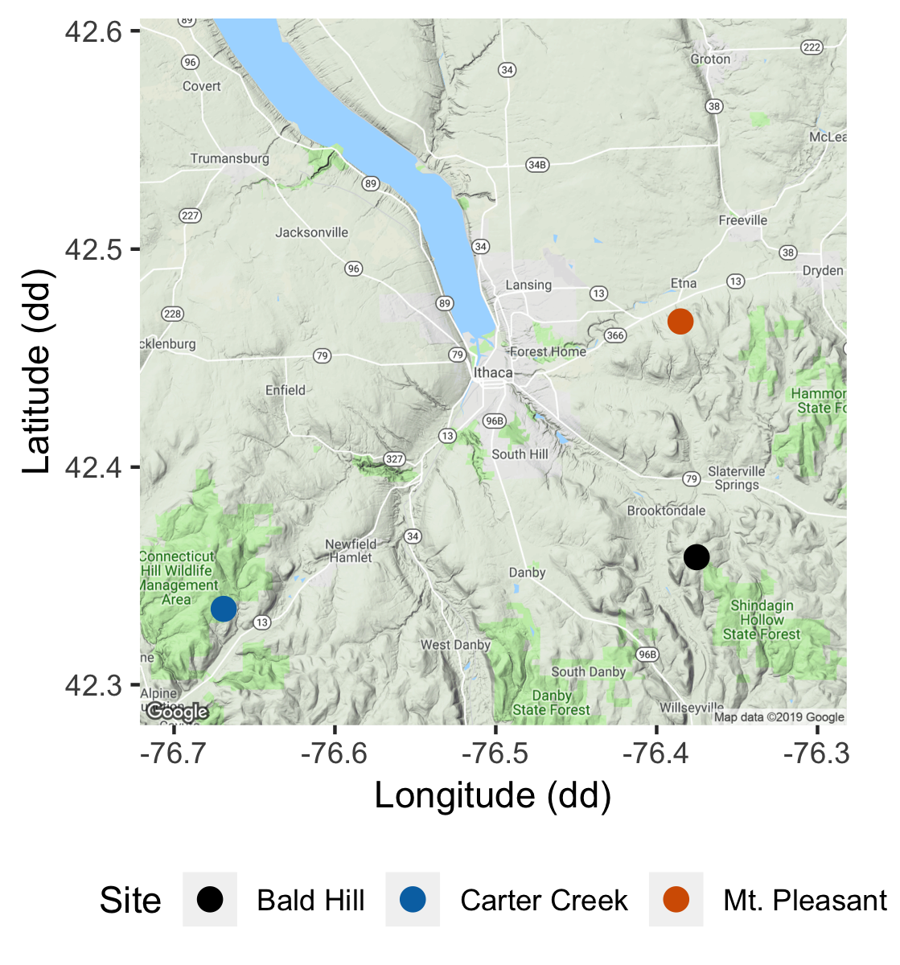
Study system
Soil fertilization treatments
Sites
0 kg ha⁻¹ yr⁻¹ N; 0 kg ha⁻¹ yr⁻¹ S
Bald Hill
0 kg ha⁻¹ yr⁻¹ N;
57 kg ha⁻¹ yr⁻¹ S
Mount Pleasant
50 kg ha⁻¹ yr⁻¹ N;
0 kg ha⁻¹ yr⁻¹ S
Carter Creek
50 kg ha⁻¹ yr⁻¹ N; 57 kg ha⁻¹ yr⁻¹ S
@EvanPerkowski
Notes:
We used the following field manipulation experiment to investigate whether changes in soil resource availability influenced leaf quantity/quality tradeoffs or water/nitrogen use tradeoffs.
Starting in 2010, our coauthor Christy Goodale set up a full-factorial nitrogen-by-sulfur field manipulation experiment at three sites in a contiguous closed canopy forest all within a 20-km radius of Ithaca, New York
This experiment was originally created to tease apart the impacts of soil pH change and soil nitrogen fertilization on forest ecosystem functions;
however, because sulfur additions acidify the soil and promote nitrogen losses over time, this system provides a unique soil nitrogen availability gradient to test our hypotheses.

Slide 12
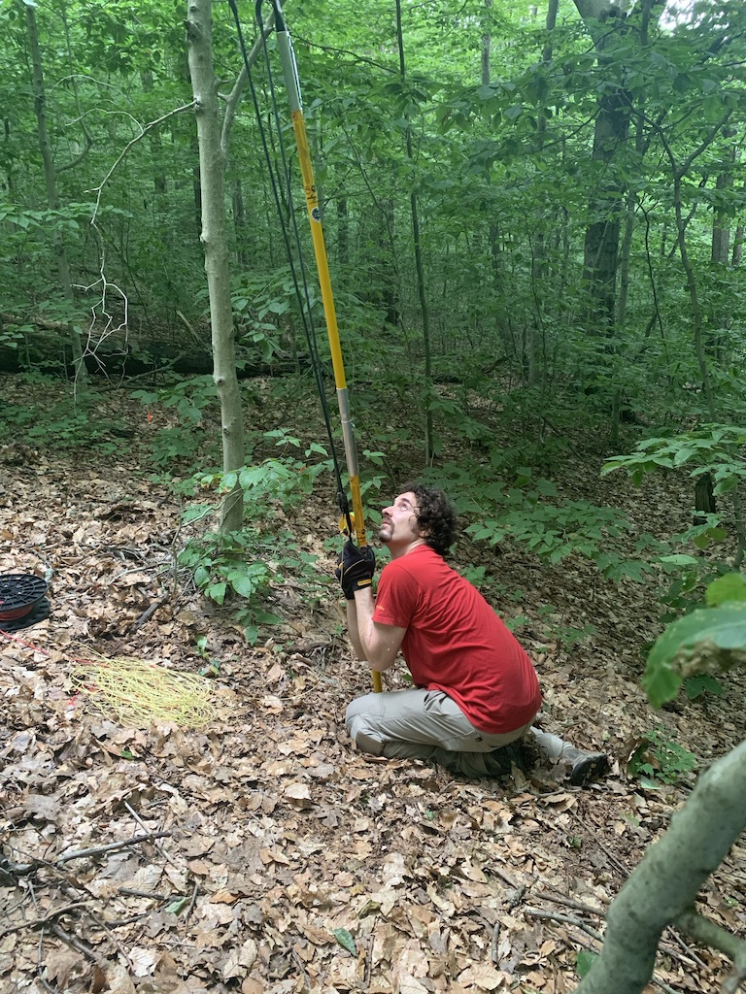
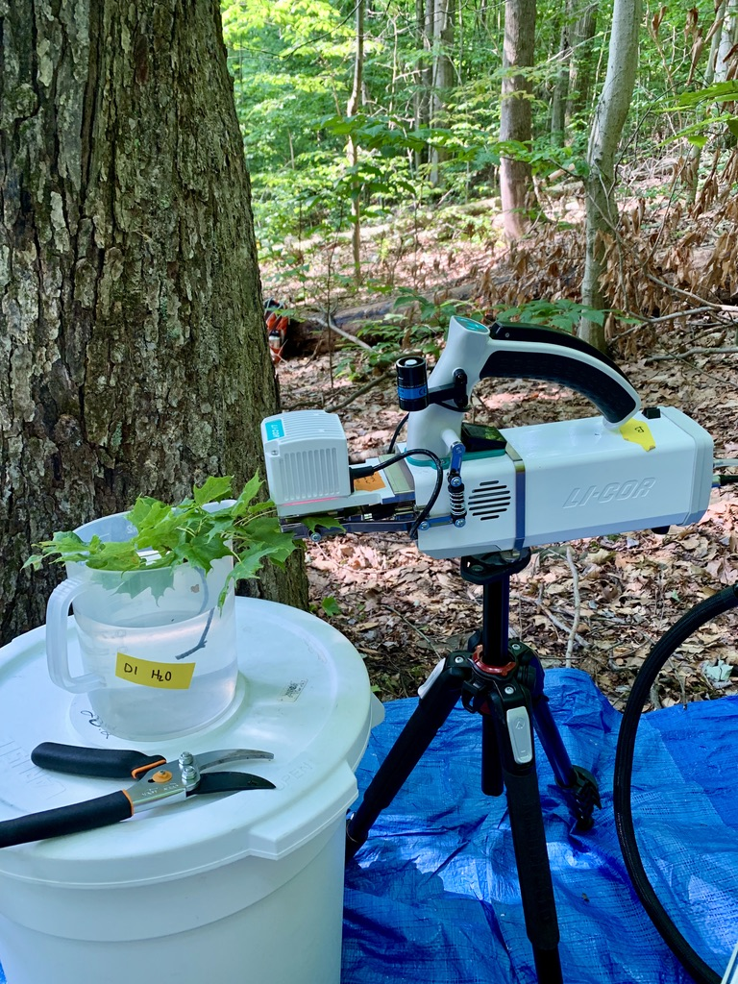
Leaf sampling
Fully sunlit canopy leaves brought down with arborist’s slingshot
Branches recut underwater
CO₂ response curve using LI-COR 6800
@EvanPerkowski
Notes:
We collected fully sunlight canopy leaves from each of the plots using an arborist’s slingshot and used a LI-COR 6800 to measure carbon dioxide response curves

Slide 13
Plant measurements
Leaf-level measurements
Whole plant measurements
Net photosynthesis and biochemical process rates
Leaf nitrogen per unit leaf area
PNUE
iWUE
Change in basal area between 2011 and 2019
Relative growth rate using allometrically-scaled whole tree biomass
@EvanPerkowski
Notes:
We measured both leaf and whole plant traits for each collected leaf sample.
We extracted net photosynthesis rate at 400 ppm CO2 and estimated Rubisco carboxylation and RuBP regeneration rates using equations from Farquhar et al. (1980).
We also quantified leaf nitrogen per unit leaf area and combined this with photosynthetic data to estimate photosynthetic nitrogen use efficiency.
Finally, we measured water-use efficiency using photosynthetic and stomatal conductance data extracted from each carbon dioxide response curve
At the whole plant level, we measured the change in basal area between 2011 and 2019 to get an estimate of woody tissue production and estimated relative growth rate between the same years using allometrically-scaled biomass data

Slide 14
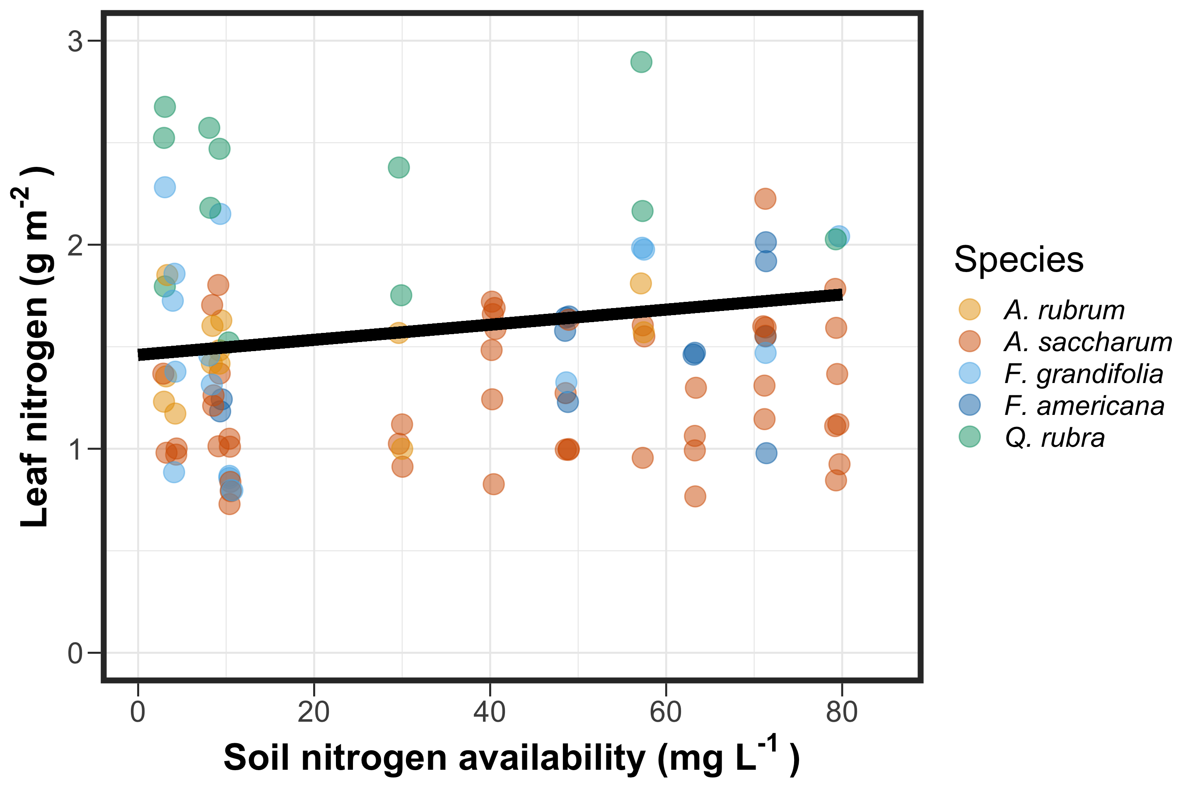
@EvanPerkowski
Notes:
I want to orient everyone on the structure of our figures
Soil nitrogen availability is represented continuously on the x-axis
Our response variable is listed on the y-axis
Individual points represent individual measurements, and different colors represent species identity of that measurement
Finally, we include trendlines where there is a statistically significant effect of nitrogen availability on a response variable.
This trendline represents patterns when averaged across species, so these patterns are more reflective of a community-level pattern than a population-level pattern

Slide 15
Soil nitrogen availability increases leaf nitrogen
20.27% increase
@EvanPerkowski

Slide 16
Soil nitrogen availability increases photosynthetic capacity
@EvanPerkowski
Notes:
Soil nitrogen availability also influenced photosynthetic capacity. In this case, we refer to photosynthetic capacity as the light saturated photosynthetic rate measured at 400 ppm CO2

Slide 17
Soil nitrogen availability increases photosynthetic capacity
20.32% increase
@EvanPerkowski
Notes:
We find that soil nitrogen availability increased photosynthetic capacity when averaged across species
These findings could suggest that increased leaf nitrogen contributed to increased photosynthetic capacity

Slide 18
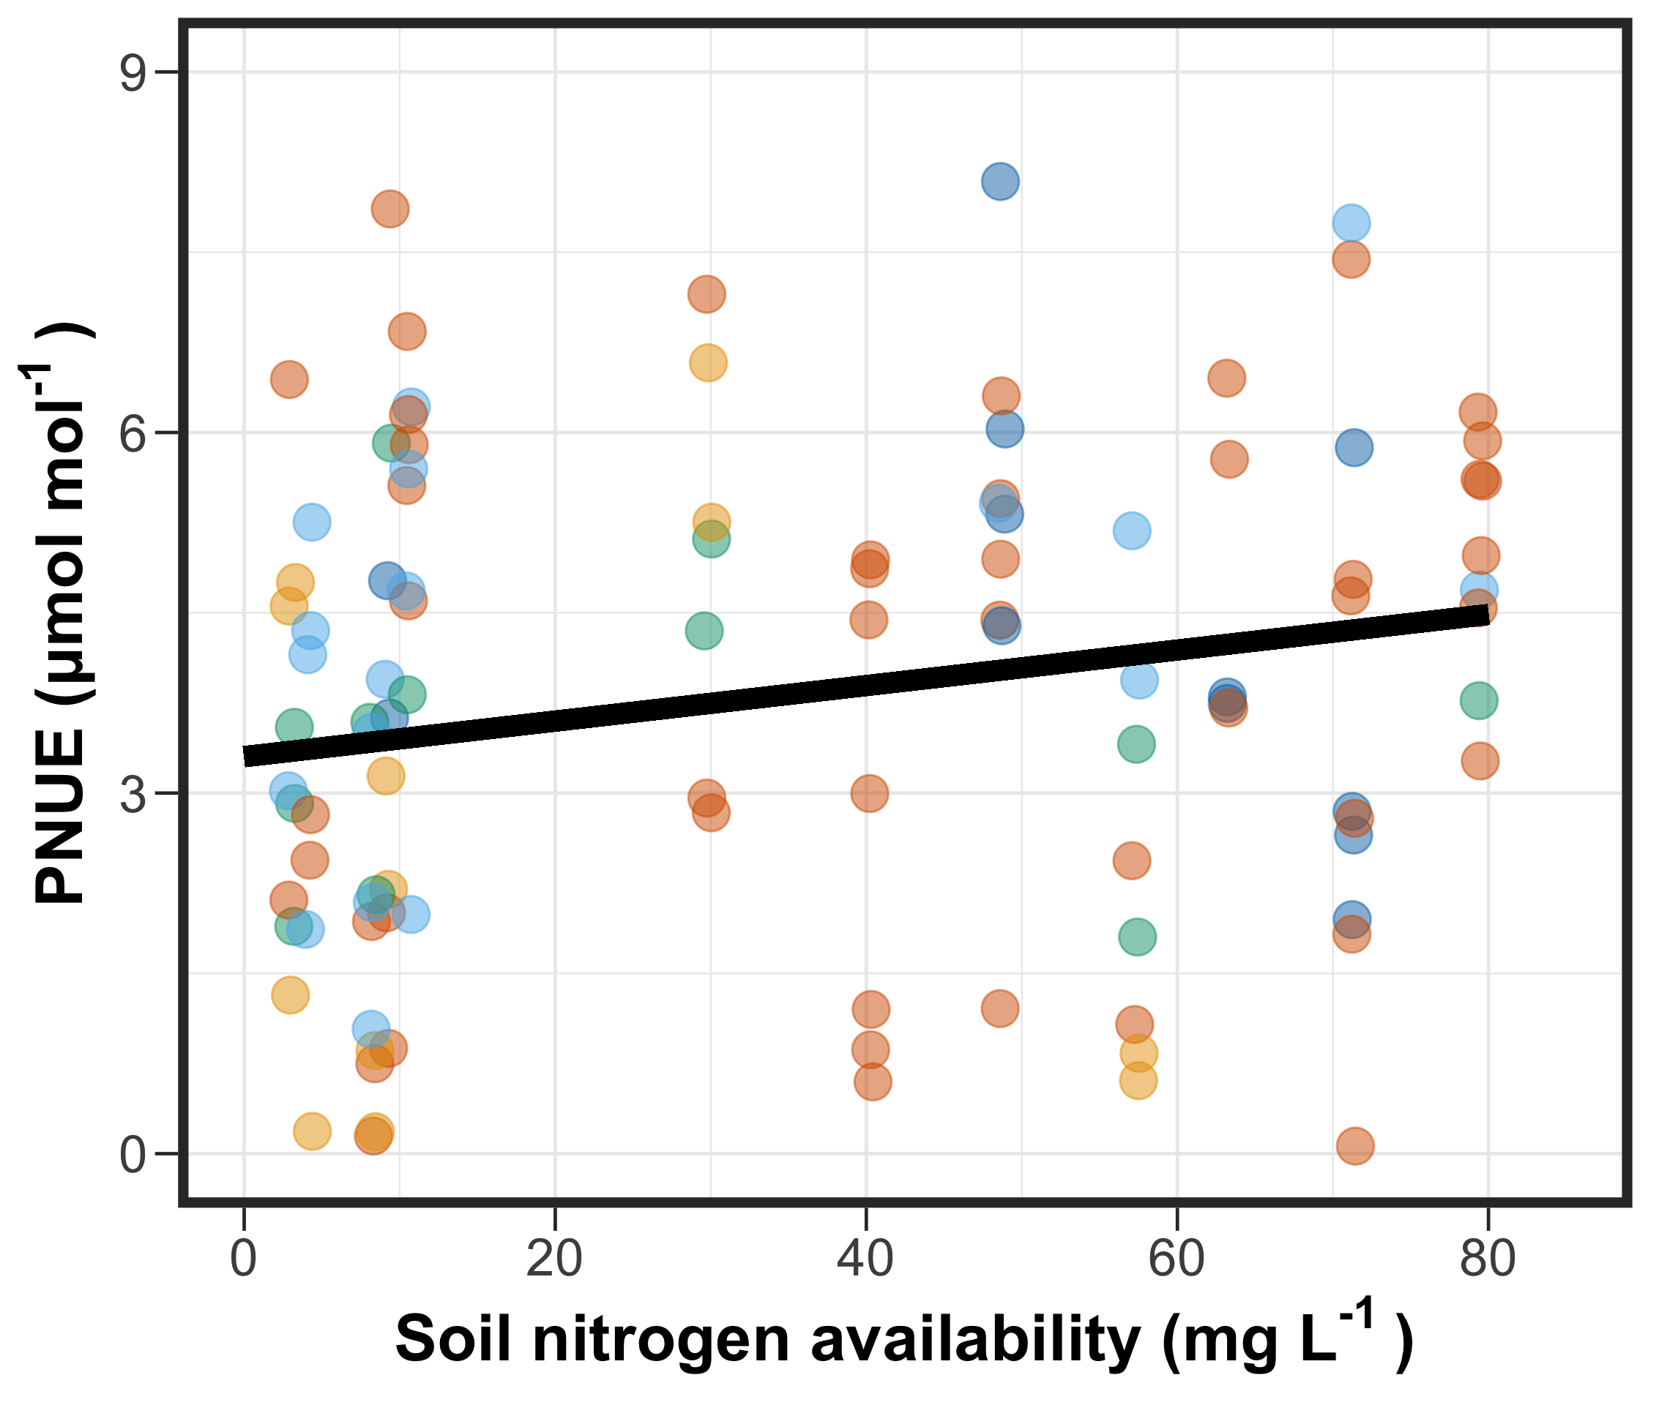
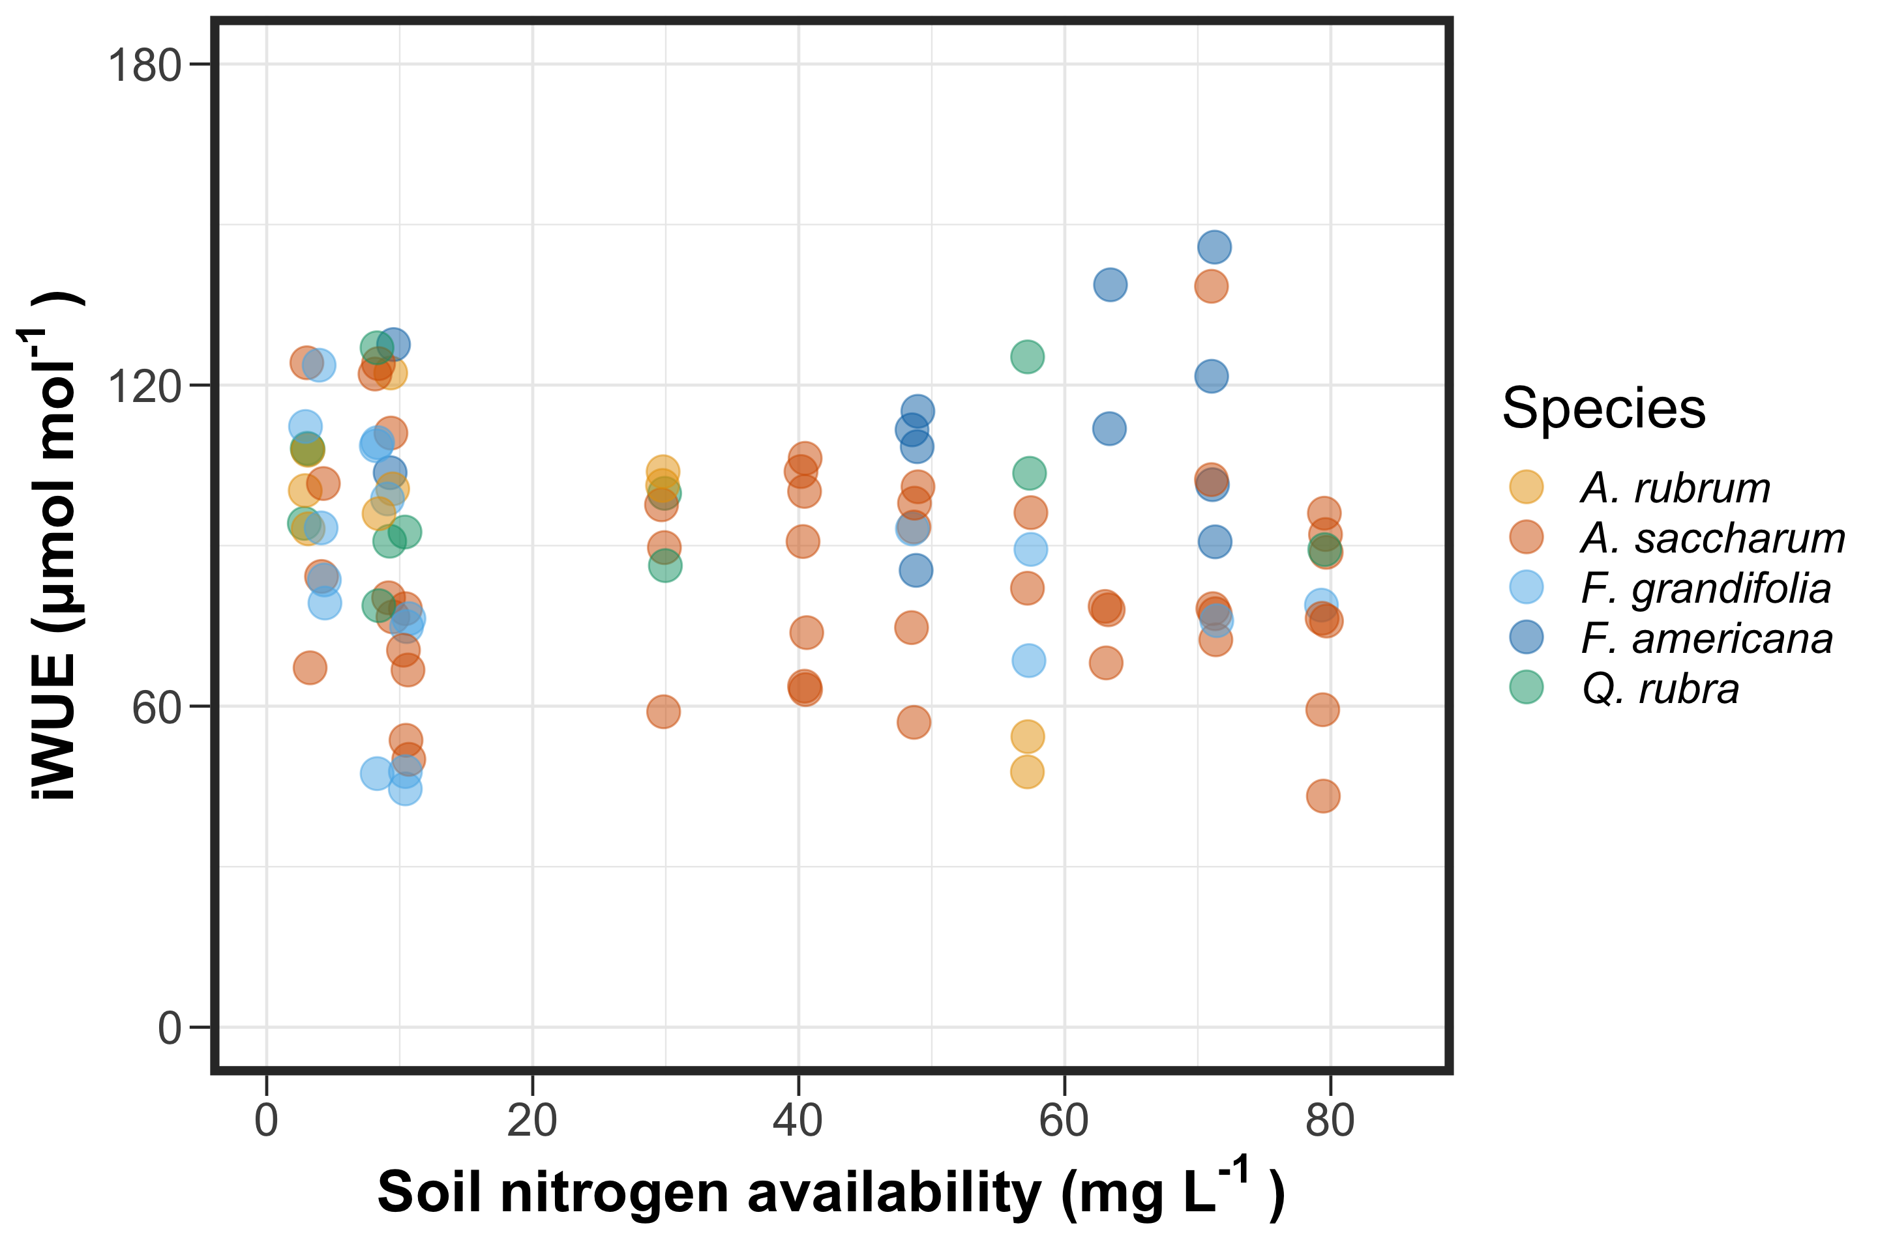
@EvanPerkowski
Notes:
Given that leaf nitrogen increased with increasing soil nitrogen availability and what we know about tradeoffs between nitrogen and water use,
we would expect that soil nitrogen availability would cause soil nitrogen to become relatively more abundant than water,
which might cause plants to trade more inefficient use of nitrogen for increasingly more efficient use of water with increasing soil nitrogen

Slide 19
Soil nitrogen availability increases photosynthetic nitrogen-use efficiency…
35.85% increase
@EvanPerkowski
Notes:
Interestingly, we observed the opposite pattern for photosynthetic nitrogen-use efficiency, where soil nitrogen availability increased photosynthetic nitrogen use efficiency.
This was likely driven by an increase in leaf nitrogen that corresponded with an increase in photosynthetic capacity

Slide 20
… but not water-use efficiency
35.85% increase
@EvanPerkowski
Notes:
However, the observed increase in photosynthetic nitrogen-use efficiency did not correspond with a shift in water-use efficiency.
This was observed both for intrinsic water-use efficiency (pictured in the right panel) and with foliar delta carbon 13 data, which is a more integrated measure of water-use efficiency across a leaf’s lifespan
Together, these findings suggest that trees in these plots are not differentially allocating nitrogen to maximize resource use, which makes sense because this is a nitrogen addition experiment in a temperate region that receives just over 900 mm of precipitation per year.
Therefore, it makes sense that we wouldn’t see a strong nitrogen/water use tradeoff, as both resources are not necessarily becoming increasingly limited or limiting in this system

Slide 21
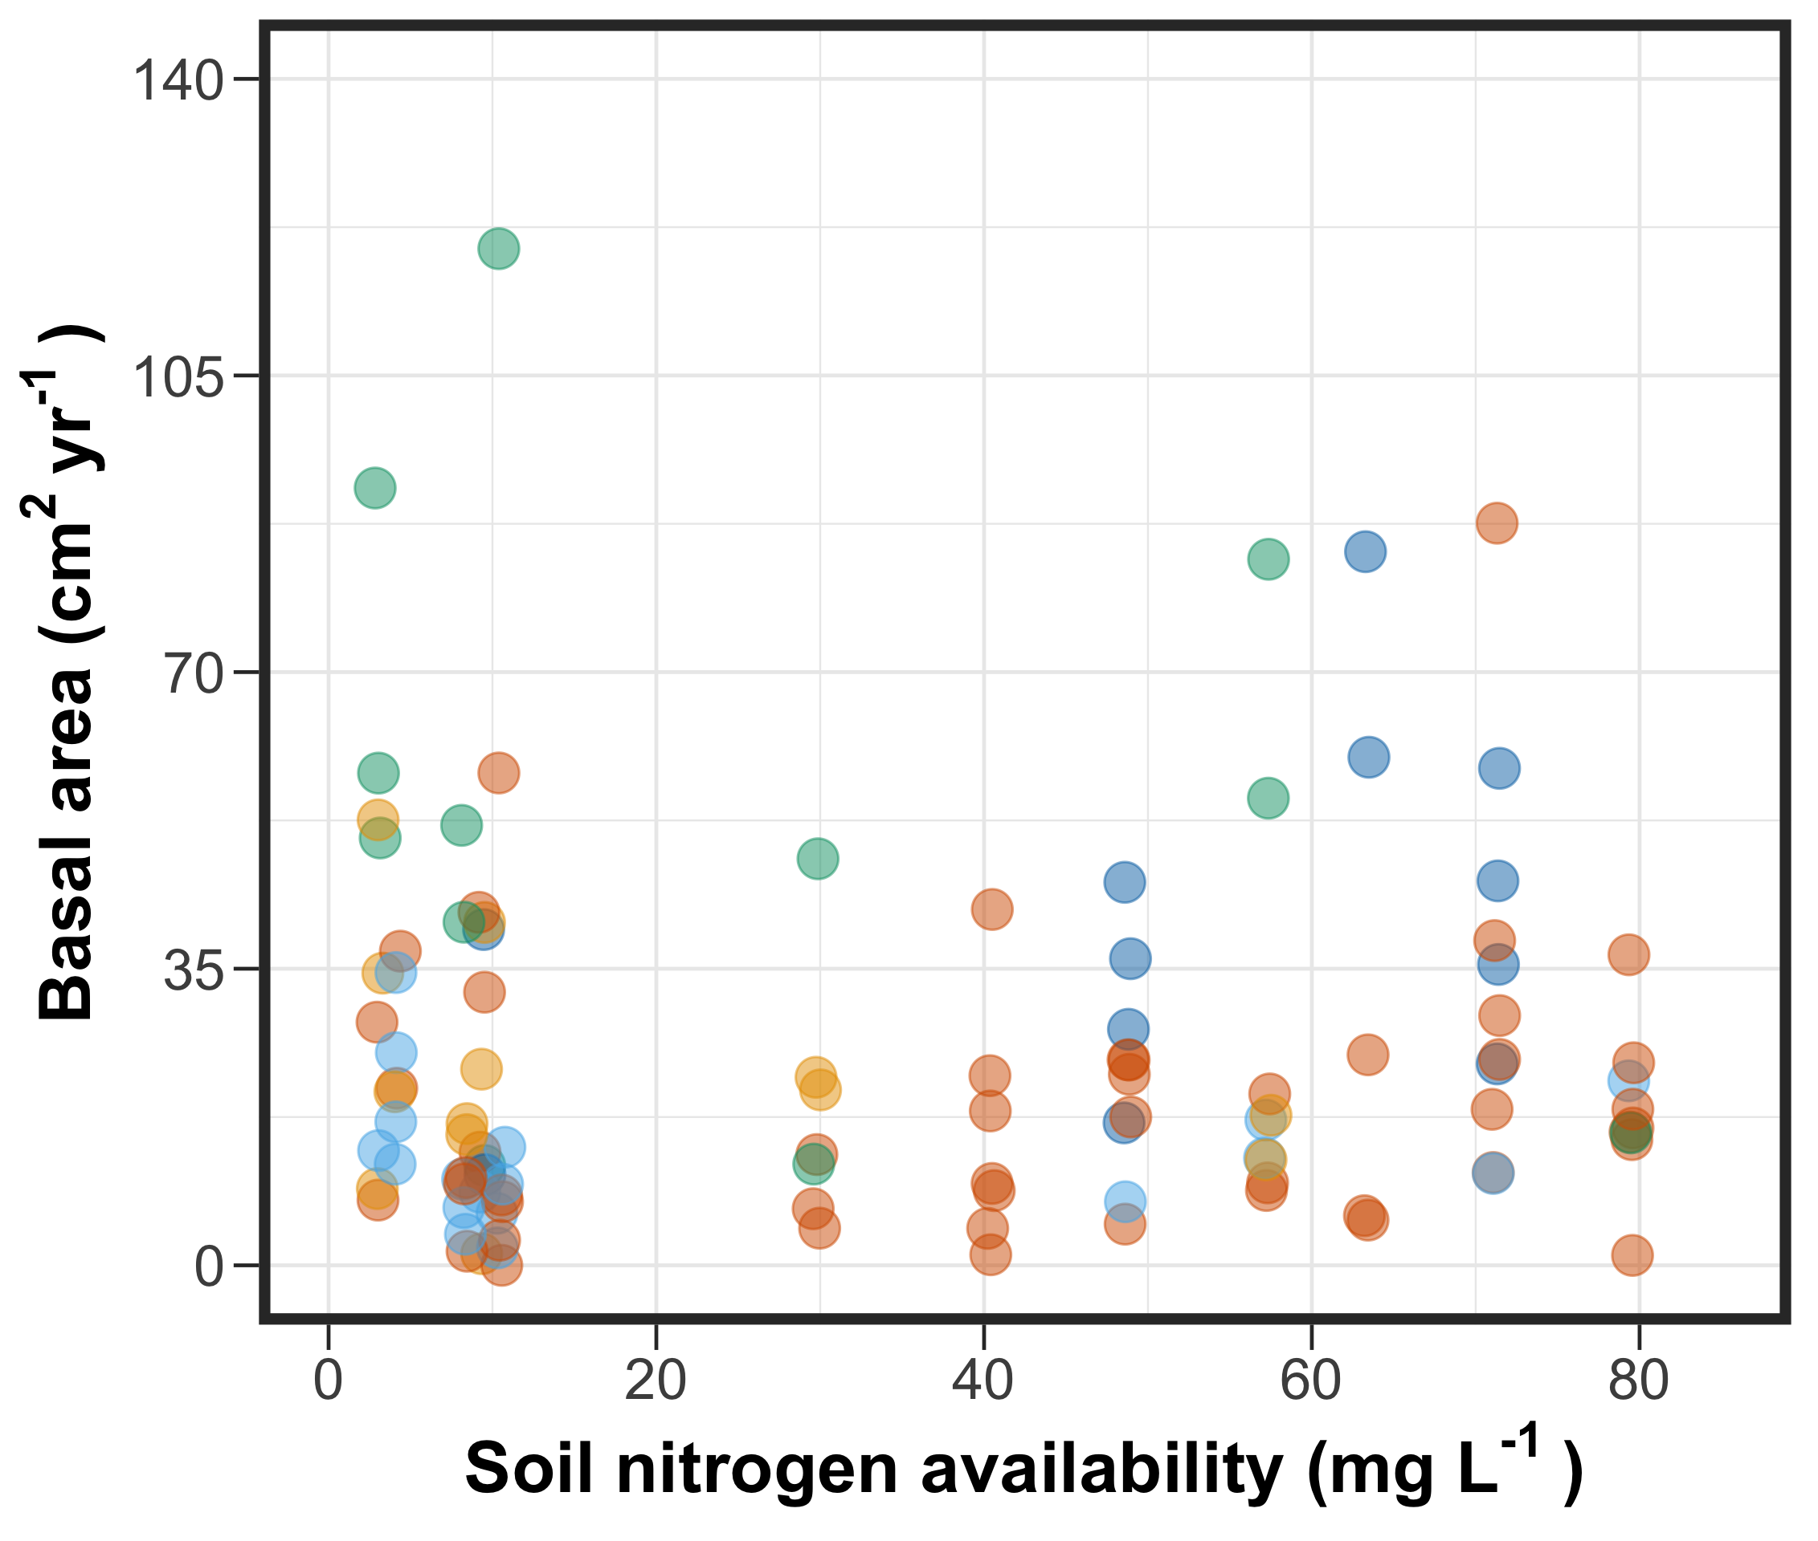
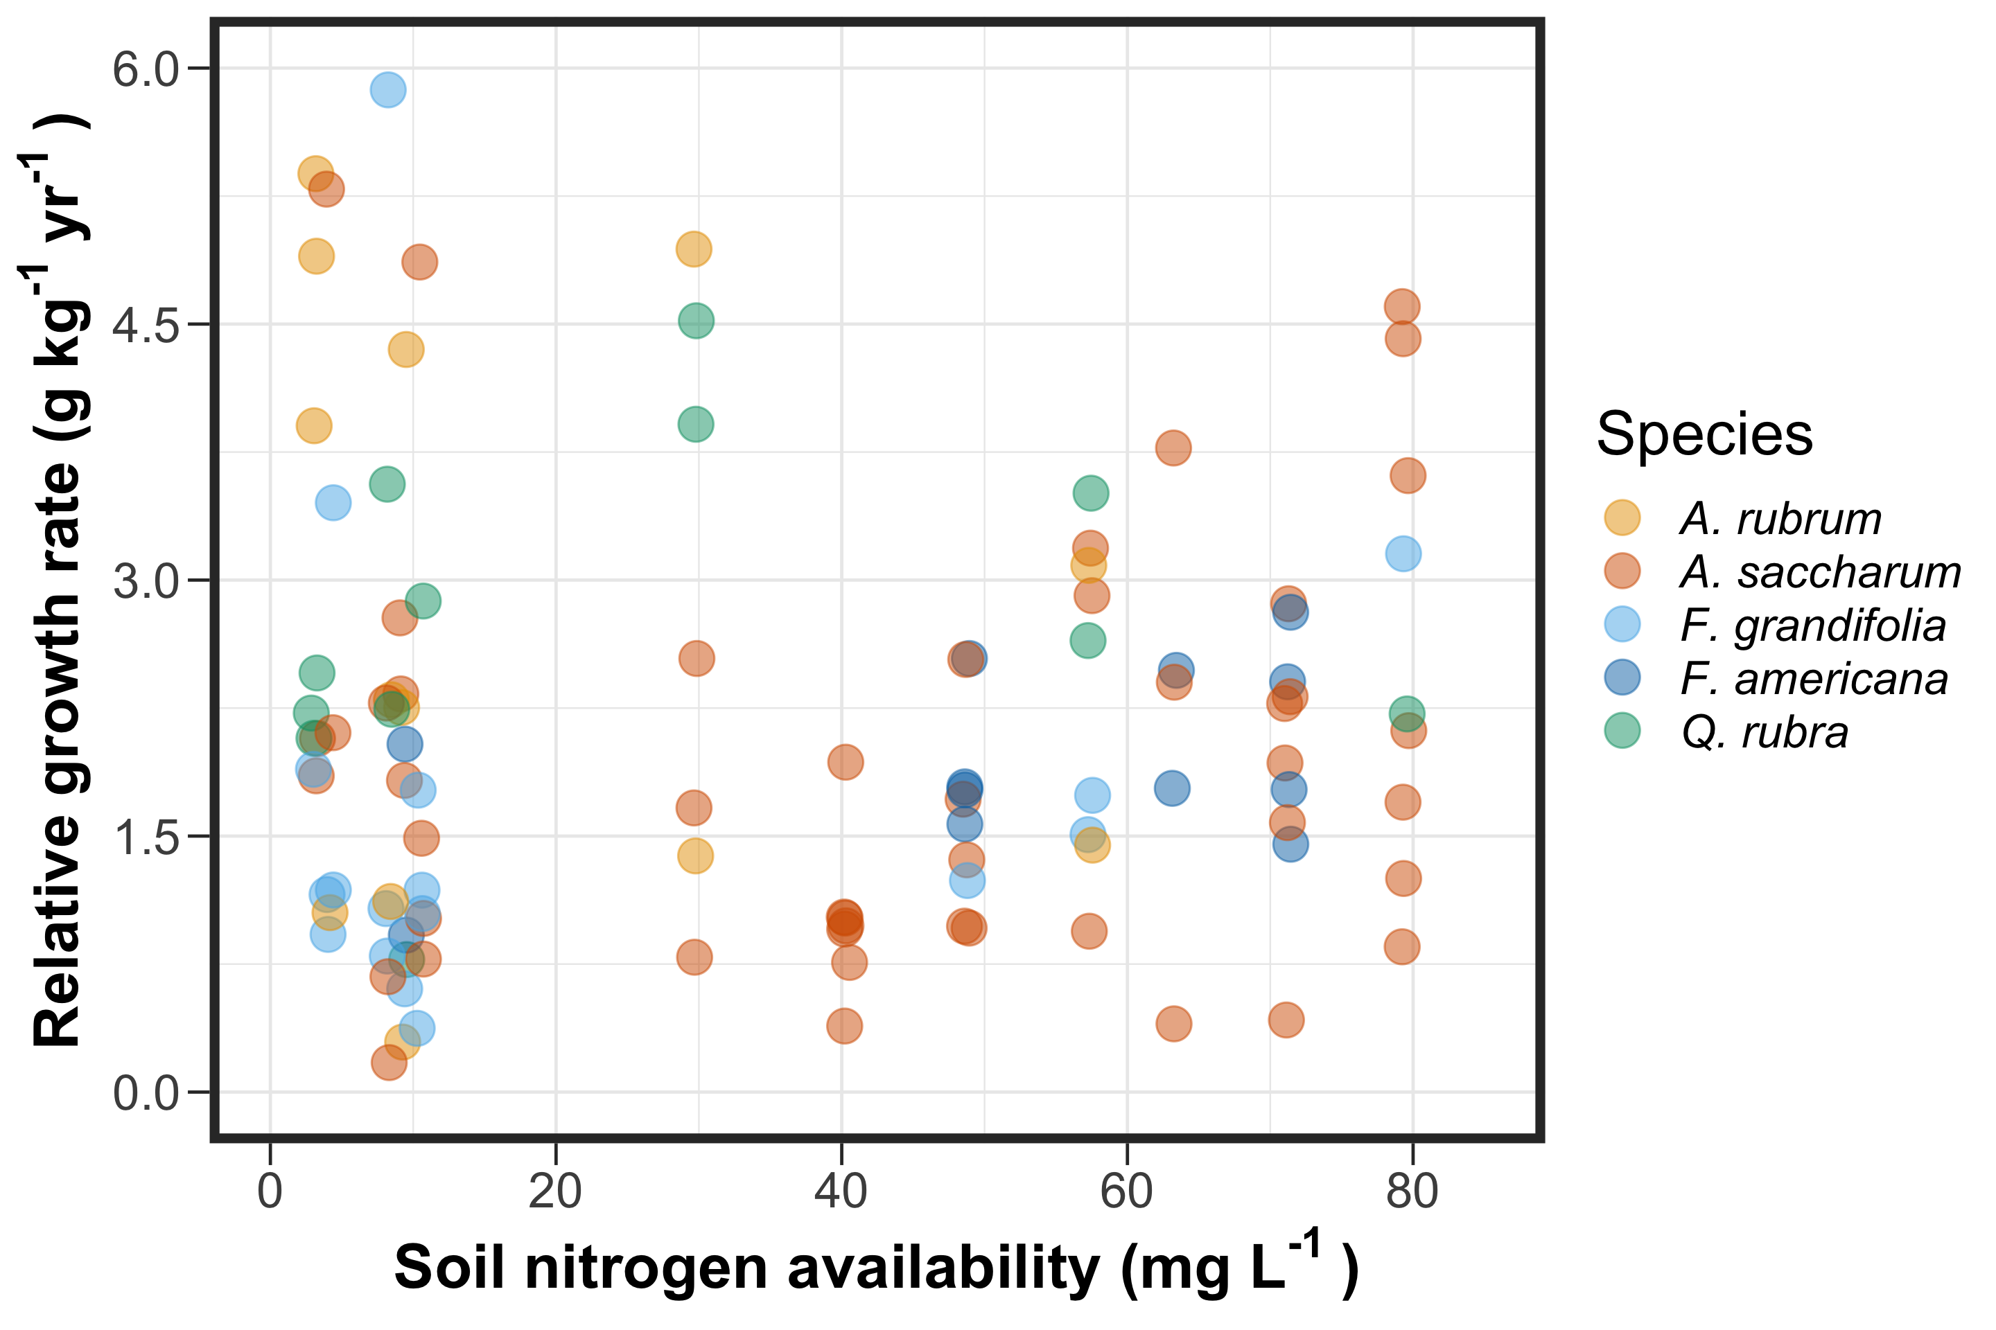
If leaf nitrogen increases with increasing soil nitrogen availability, then:
No change
No change
@EvanPerkowski
Notes:
Given what we know about tradeoffs between leaf and whole plant nitrogen allocation, we expected that there would not be a large impact on the relative change in tree basal area or growth rate.
This was because we observed an increase in leaf nitrogen, which would come at the expense of whole plant nitrogen allocation.

Slide 22
Soil nitrogen availability does not influence woody tissue production…
@EvanPerkowski
Notes:
Indeed, we found that basal area generally did not change with increasing soil nitrogen availability

Slide 23
… or relative growth rate
@EvanPerkowski
Notes:
Relative growth rate also did not change with increasing soil nitrogen availability

Slide 24
Revisiting Option 1
Did soil N allow photosynthesis rates to be achieved with higher water use efficiency at the expense of nitrogen-use efficiency?
@EvanPerkowski
Bialic-Murphy et al. (2021) Ecol. Letters
Notes:
Revisiting the two options mentioned at the beginning of this talk, we expected that soil nitrogen would increase leaf nitrogen and would allow plants to achieve similar photosynthetic rates with higher water-use efficiency

Slide 25
Revisiting Option 1
Did soil N allow photosynthesis rates to be achieved with higher water use efficiency at the expense of nitrogen-use efficiency?
No, increased soil N increased nitrogen-use efficiency and did not influence water-use efficiency
@EvanPerkowski
Bialic-Murphy et al. (2021) Ecol. Letters
Notes:
But, while increases in soil nitrogen increased leaf nitrogen, this corresponded with an increase in nitrogen-use efficiency and did not affect water-use efficiency
Nitrogen-use efficiency had directionally the opposite effect than we had expected, and this is probably due to two reasons:
An increase in leaf nitrogen corresponded with an increase in net photosynthesis
Nitrogen and water are not necessarily limited or limiting in this system, so we might not expect to see a strong water/nitrogen use tradeoff signature

Slide 26
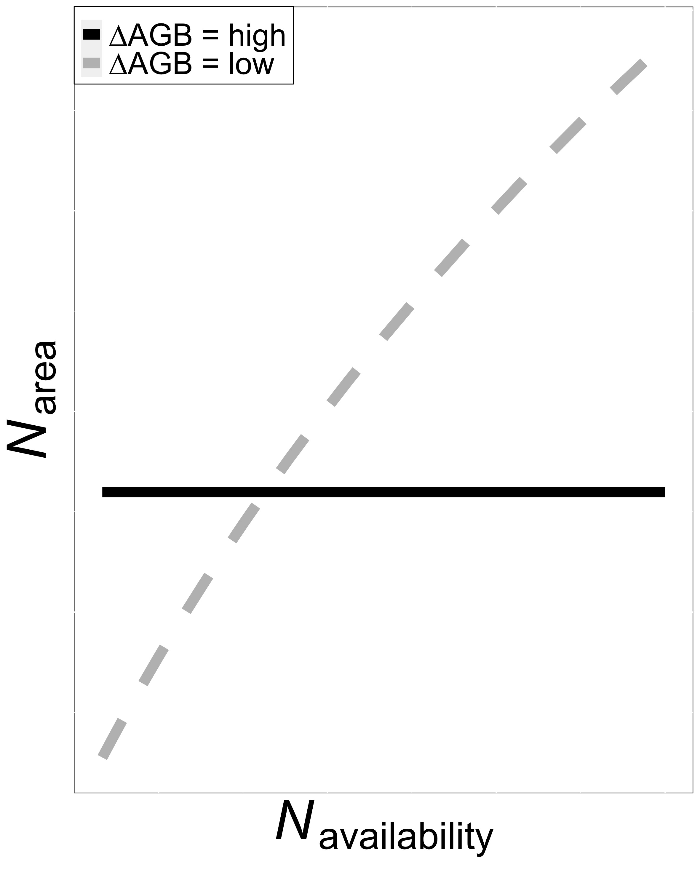
Revisiting Option 2
Did soil N invoke tradeoffs between biomass production and N_{area}?
@EvanPerkowski
Smith et al. (in prep)
Notes:
We also expected that whole plant growth would come at the expense of leaf nitrogen.
If whole plant growth experienced a strong simulation with increasing soil nitrogen availability, then leaf nitrogen would likely not change.
Alternatively, if leaf nitrogen increased with increasing soil nitrogen availability, then whole plant growth would likely not change

Slide 27
Revisiting Option 2
Did soil N invoke tradeoffs between biomass production and N_{area}?
Yes! Soil N did not influence whole plant growth, but increased N_{area}.
@EvanPerkowski
Smith et al. (in prep)
Notes:
Indeed, we found that soil nitrogen availability increased leaf nitrogen, but did not influence either measure of whole plant growth.
These patterns support previously observed tradeoffs between leaf and whole plant nitrogen allocation;
however, support patterns we would expect in an open canopy system

Slide 28
Final thoughts
Trees invested more nitrogen toward leaf tissue at expense of whole plant growth
Overinvest in leaf nitrogen to be more productive during high sunlight hours
System is experiencing high rates of tree mortality – freeing of canopy space?
@EvanPerkowski
Notes:
Our first explanation for this could be that plants may overinvest in leaf nitrogen in forest systems to be more productive during high sunlight hours for top canopy leaves or sunflecks in intermediate or lower canopy leaves. This would allow plants to achieve high rates of photosynthesis under periods of high light and would increase their daily net carbon assimilation
Alternatively, this system is experiencing high rates of tree mortality due to bark disease and herbivory. This could free the canopy space to the point where trees have more accessible light than originally possible, which could cause individuals to shift their allocation strategies to mimick that of an open canopy system

Slide 29
Future and Ongoing Work
What is the role of light availability in driving demand to allocate nitrogen toward photosynthetic leaf tissue vs. whole plant growth?
Are these patterns observed in other ecosystem and/or different canopy architecture types?
How do these results compare to those simulated by Earth system models?
@EvanPerkowski
Notes:
This work has spawned a few questions that could be the subject of future work.
First,....
Second, ....
Third, ...

Slide 30
Acknowledgements
USDA NIFA Award 2015-67003-23485
Texas Tech University
Risa McNellis (TTU)
Omair Irfan (Cornell)
Romin Abdolahzadi (Cornell)
Members of Schwilk & van Gestel labs (TTU)
Dr. Lizz Waring (TTU)
@EvanPerkowski
Notes:
Finally, this work could not have been done without the financial support of a USDA NIFA Award and Texas Tech University.
Additionally, I’d like to thank Risa, Omair, and Romin for their help with securing housing and/or assisting with field work.
Finally, I would like to thank members of the Schwilk and van Gestel labs for feedback on data analysis and Dr. Lizz Waring for being a sounding board of my many ideas

Slide 31
Thank you!
@EvanPerkowski

